Slide 1




Savitribai Phule Pune University
Affiliated
Pravara Rural Education Societey’s
Sir Visvesvaraya Institute of Technology, Nashik

Slide 2


Sir Visvesvaraya Institute of Technology ,Chincholi, Nashik
Project Presentation on
“ SIGN LANGUAGE DETECTION USING MACHINE LEARNING ”
Project Coordinator Ms. Archana Ugale
Project Guide (HOD IT) Mr. Rushikesh Bhalerao

Slide 3
Student details
Piyush Tanaji Bhujbal, Roll no: (190278508).
Krushna Vikas Chavan, Roll no: (190278511)
Rutik Sunil Malave.Roll no: (190278544)
Shreyas Ganesh Waghchaure, Roll no: (190278579)

Slide 4
Table of Contents
Abstract
Introduction
Literature Survey
Aim
Objective
Propose System
Propose Model
Architecture of the CNN algorithm
UML Diagram
Implementation
Models Accuracy and loss Comparison
Conclusion

Slide 5
Abstract
The dumb and deaf people have the most common problem of communication with the normal people. The physically challenged people who are disabled to talk and hear need to find a way of communication medium through which they can express their thoughts and solve their problems. Thus, to work upon it some experts designed a Sign Language.
In the above review we a team of four students under the guidance of our project guide are just giving a rough improvement and adding some automation techniques with Machine Learning and Computer Vision through which we are attempting to create the Indian Sign Language Detection algorithm through Deep Neural Networks.
The main aim of this project is to create a simple, easy and ready to use application that predicts the symbol shown by the user in front of the camera and then the ML model in the backend predicts the output and shows it live on the screen.

Slide 6
Introduction
Communication is very important to human beings, as it enables us to express ourselves. We communicate through the speech, gestures, body language, reading, writing. However, for the speaking and hearing impaired minority, there is a communication gap.
This can be very helpful for the deaf and dumb people in communicating with others as knowing sign language is not something that is common to all, moreover, this can be extended to creating automatic editors, where the person can easily write by just their hand gestures.
Sign Language is a form of communication used primarily by people hard of hearing or deaf. This type of gesture-based language allows people to convey ideas and thoughts easily overcoming the barriers caused by difficulties from hearing issues.

Slide 7
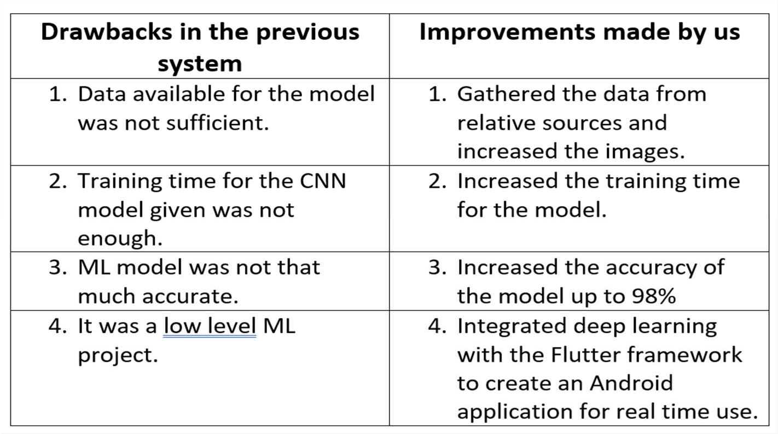

Literature Survey

Slide 8
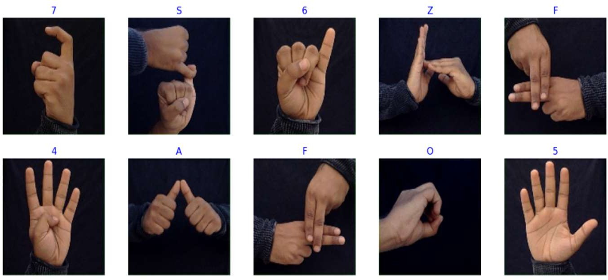
Aim
The purpose of this project is to provide an efficient and accurate way to convert sign language into
Graphical context
Using Machine learning and flutter we look forward to create
An Application that help both deaf and non-deaf people to communicate with each other.

Slide 9
Objective
The purpose of this project is to provide an efficient and accurate way to convert sign language into Graphical context
Using Machine learning and flutter we look forward to create
An Application that help both deaf and non-deaf people to communicate with each other.
The Main objective of the project is to give an interface where deaf and non-deaf people can easily understand sign language through a graphical context.

Slide 10
Proposed System
The goal of this project was to build a neural network able to classify which letter of the Indian Sign Language (ISL) alphabet is being signed, given an image of a signing hand.
This project is a first step towards building a possible sign language translator, which can take communications in sign language and translate them into written and oral language. Such a translator would greatly lower the barrier for many deaf and mute individuals to be able to better communicate with others in day to day interactions
The objective of this project was to see if neural networks are able to classify signed ISL letters using simple images of hands taken with a personal device such as a laptop webcam.

Slide 11
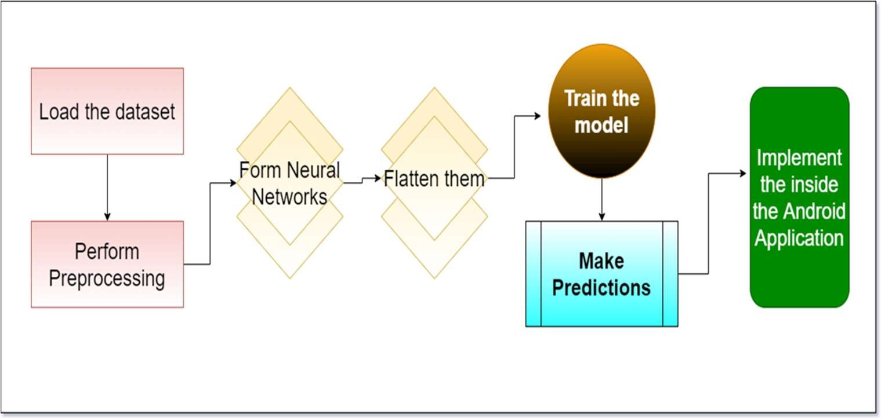

Architecture

Slide 12
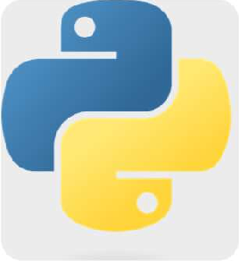



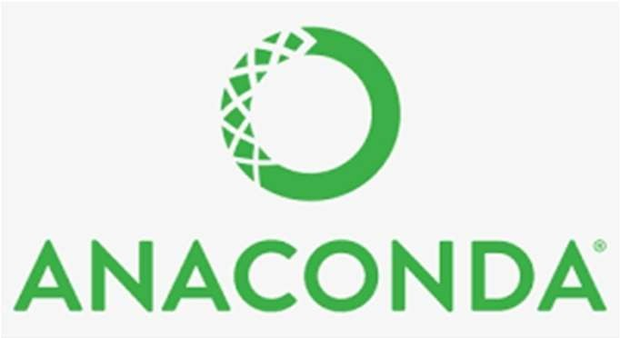

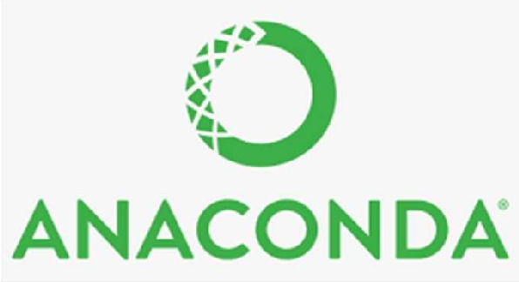

Technologies used for the Project
Python 3.9.7 for Machine Learning.
Flutter for Android Application development and User Interface Development.
Anaconda3 as an environment for ML implementations.
Android Studio as a software for Android application design.

Slide 13
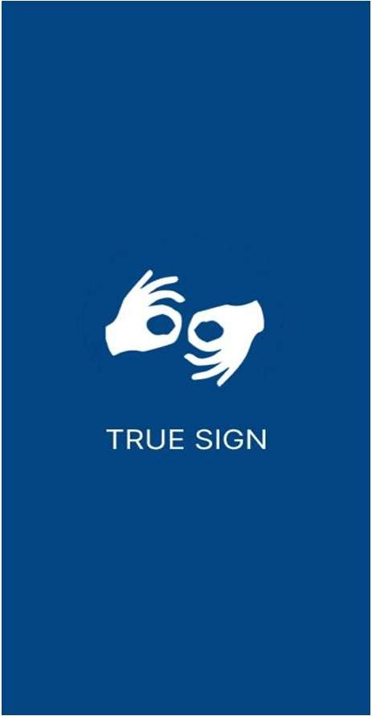
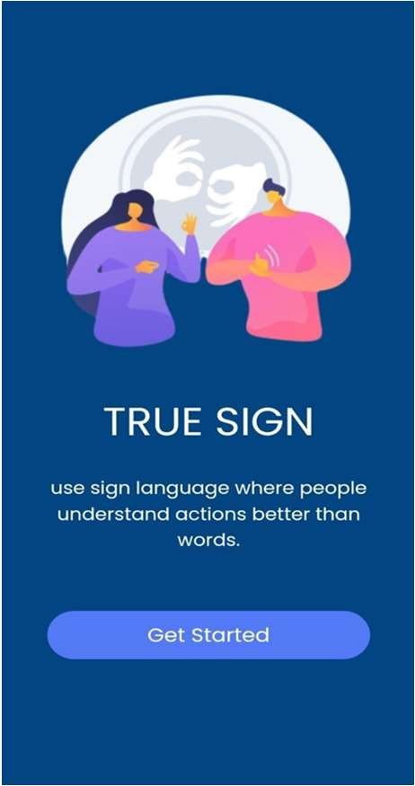
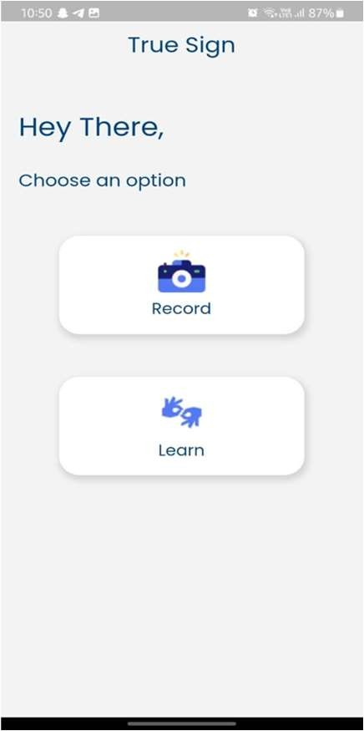
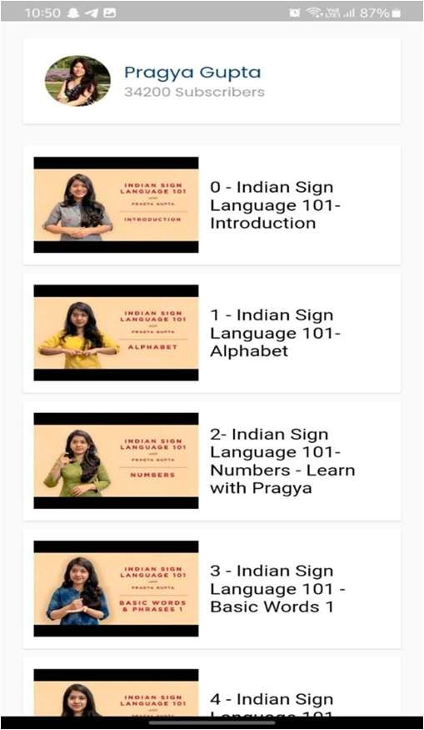
Propose Model

Slide 14
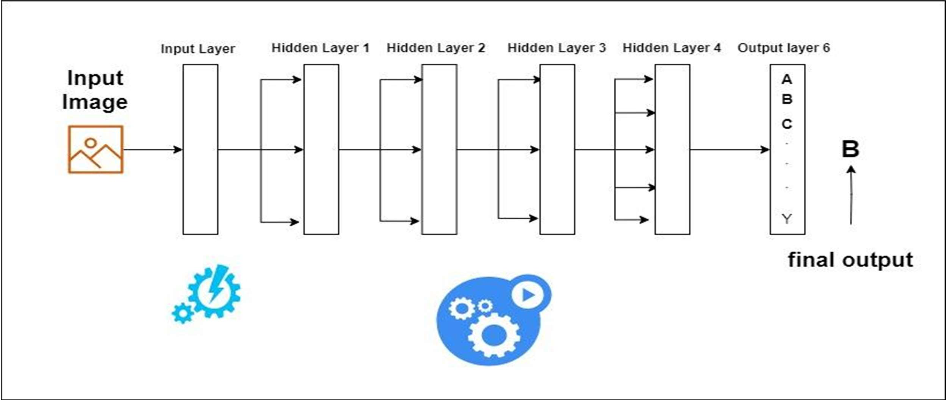
Architecture of the CNN algorithm

Slide 15
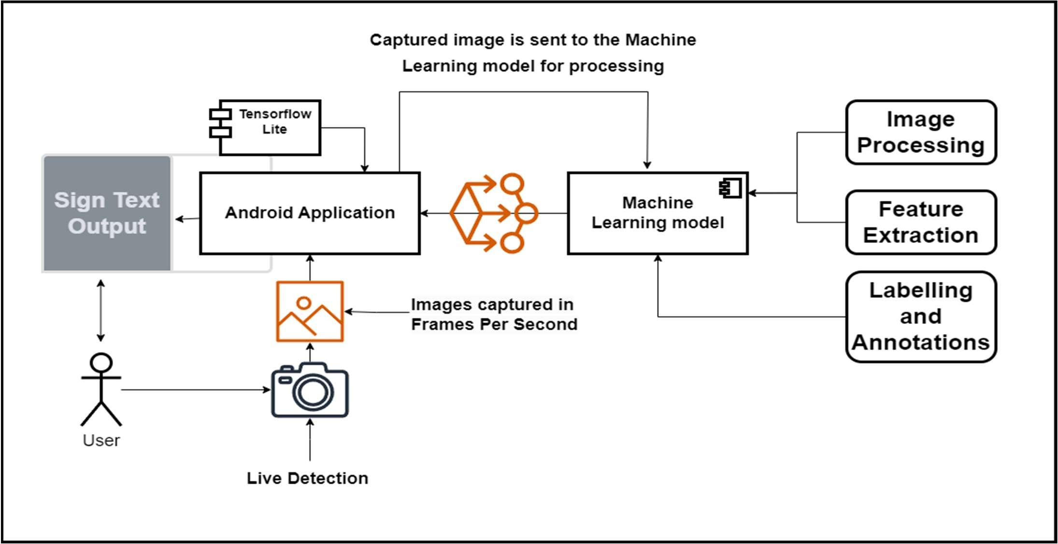
UML Diagram

Slide 16
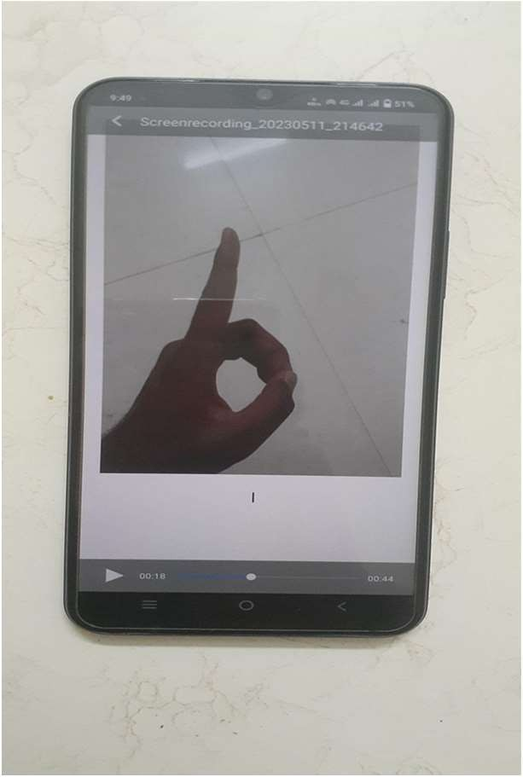
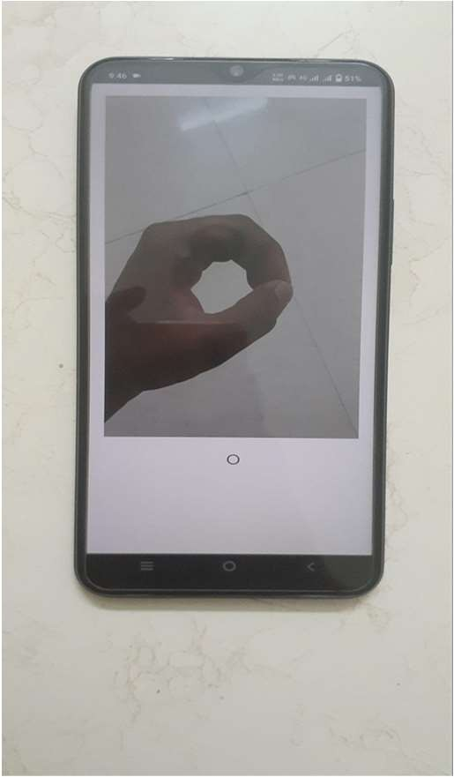
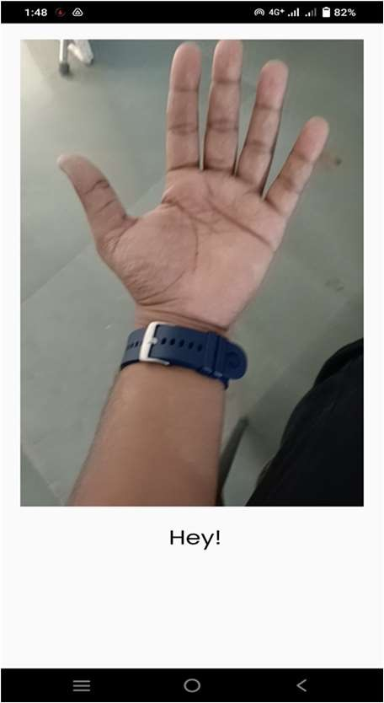
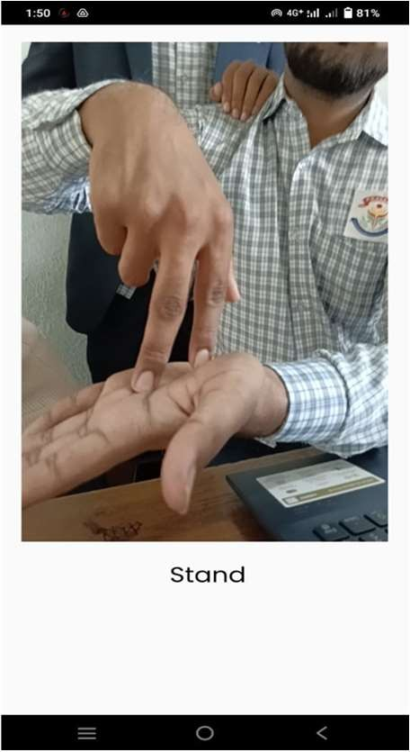
Implementation

Slide 17
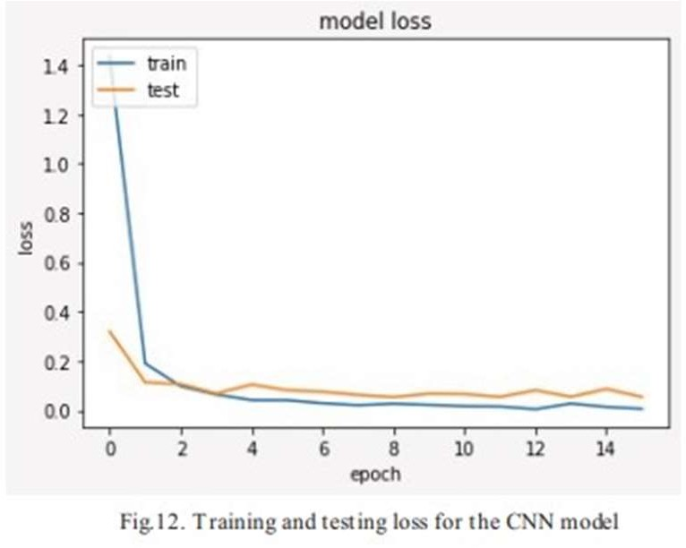
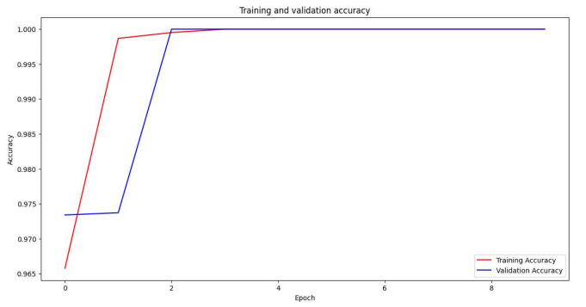
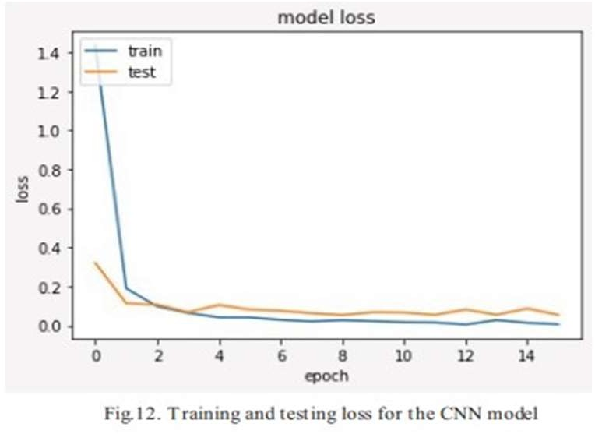
Models Accuracy and loss Comparison
Recent Model Loss and Accuracy
Previous Model loss and Accuracy

Slide 18
Conclusion
Our project on Indian Sign Language Detection using Machine Learning Android application has successfully developed a user-friendly and accurate solution for bridging the communication gap between individuals with speech and hearing impairments and the general population. By leveraging machine learning techniques, we have created an intuitive application that can recognize and translate Indian Sign Language gestures in real-time, empowering individuals with disabilities to express themselves effectively and fostering inclusivity in society.

Slide 19
Website Portfolio
https://piyushbl45t.github.io/Project-Portfolio-Website/
https://github.com/PiyushBL45t/ISL---Project-4th-year-SVIT

Slide 20
Thank You !!!

